Slide 1
 | Mean Temperature (SD)
Population | 2.0 Treatment | 4.5 Treatment | 7.0 Treatment | 9.0 Treatment
Konnevesi | 2.2 (1.5) | 4.0 (0.7) | 6.9 (0.5) | 8.0 (0.6)
Superior | 2.0 (0.5) | 4.4 (0.2) | 6.9 (0.2) | 8.9 (0.3)
Ontario | 2.0 (0.5) | 4.4 (0.2) | 6.9 (0.2) | 8.9 (0.3)

Slide 2
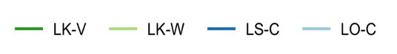
Legend Labels
: Lake Konnevesi - vendace (C. albula)
: Lake Konnevesi - European whitefish (C. lavaretus)
: Lake Superior - Cisco (C. artedi)
: Lake Ontario - Cisco

Slide 3
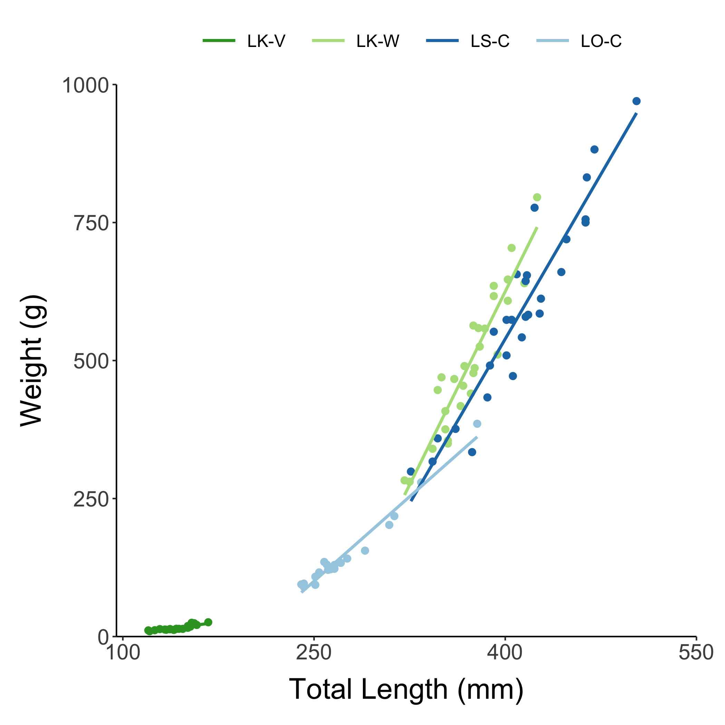
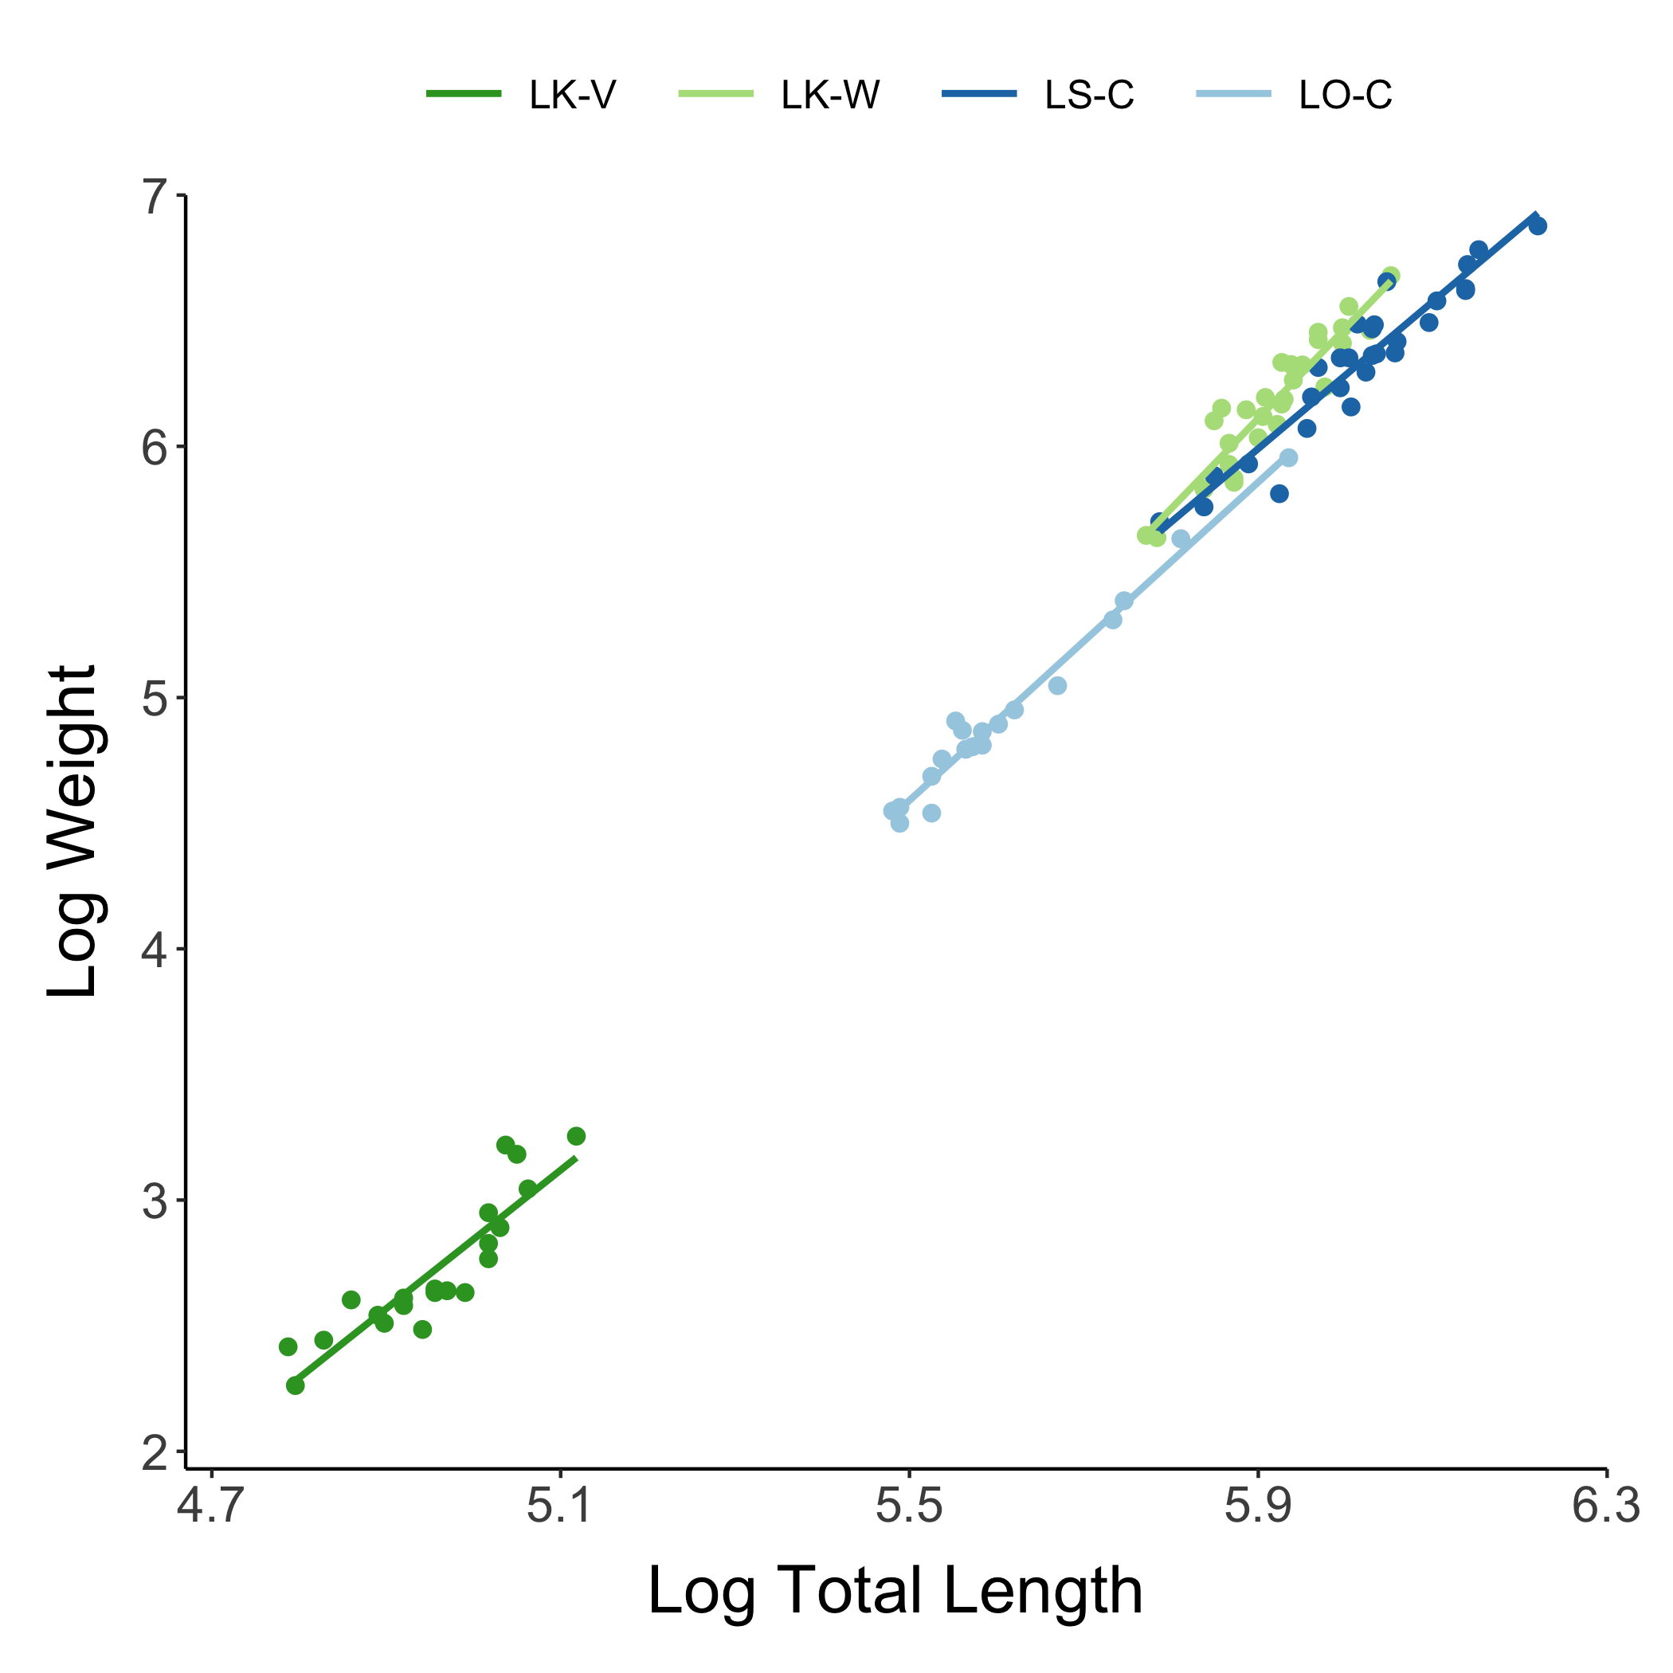
Figure X. Untransformed (left) and log-transformed (right) weight-length relationships for male and female adults used in the experiments from each population.

Slide 4
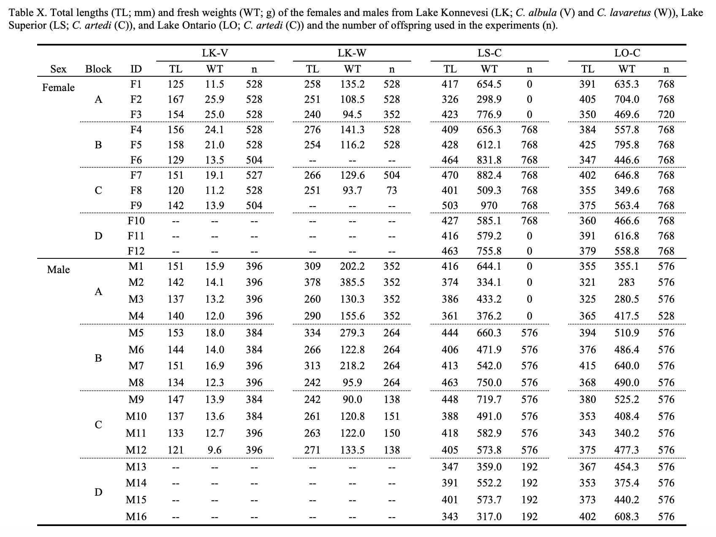

Slide 5
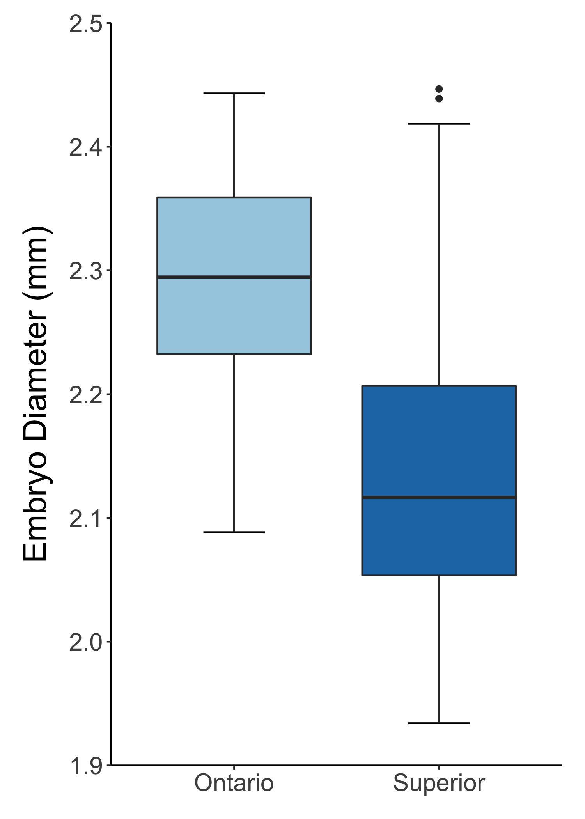
Figure X. Embryo diameter at fertilization boxplot from Lake Ontario and Lake Superior.

Slide 6
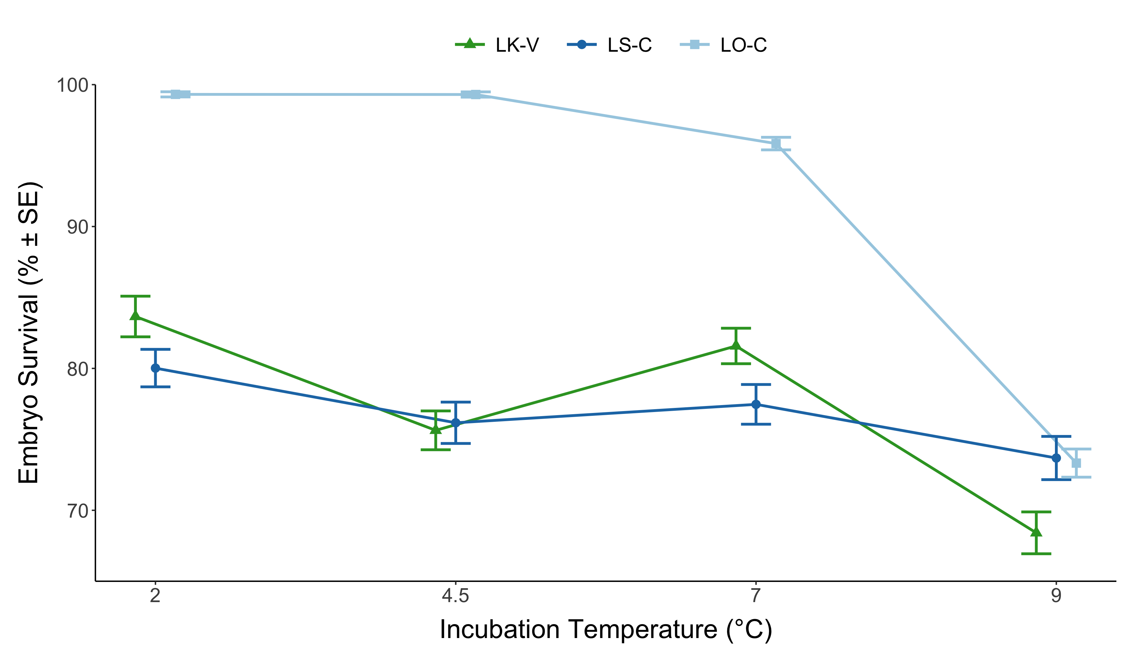
Figure X. Mean embryo survival for each population, excluding European whitefish, at all temperature treatments. Error bars indicate standard error.

Slide 7
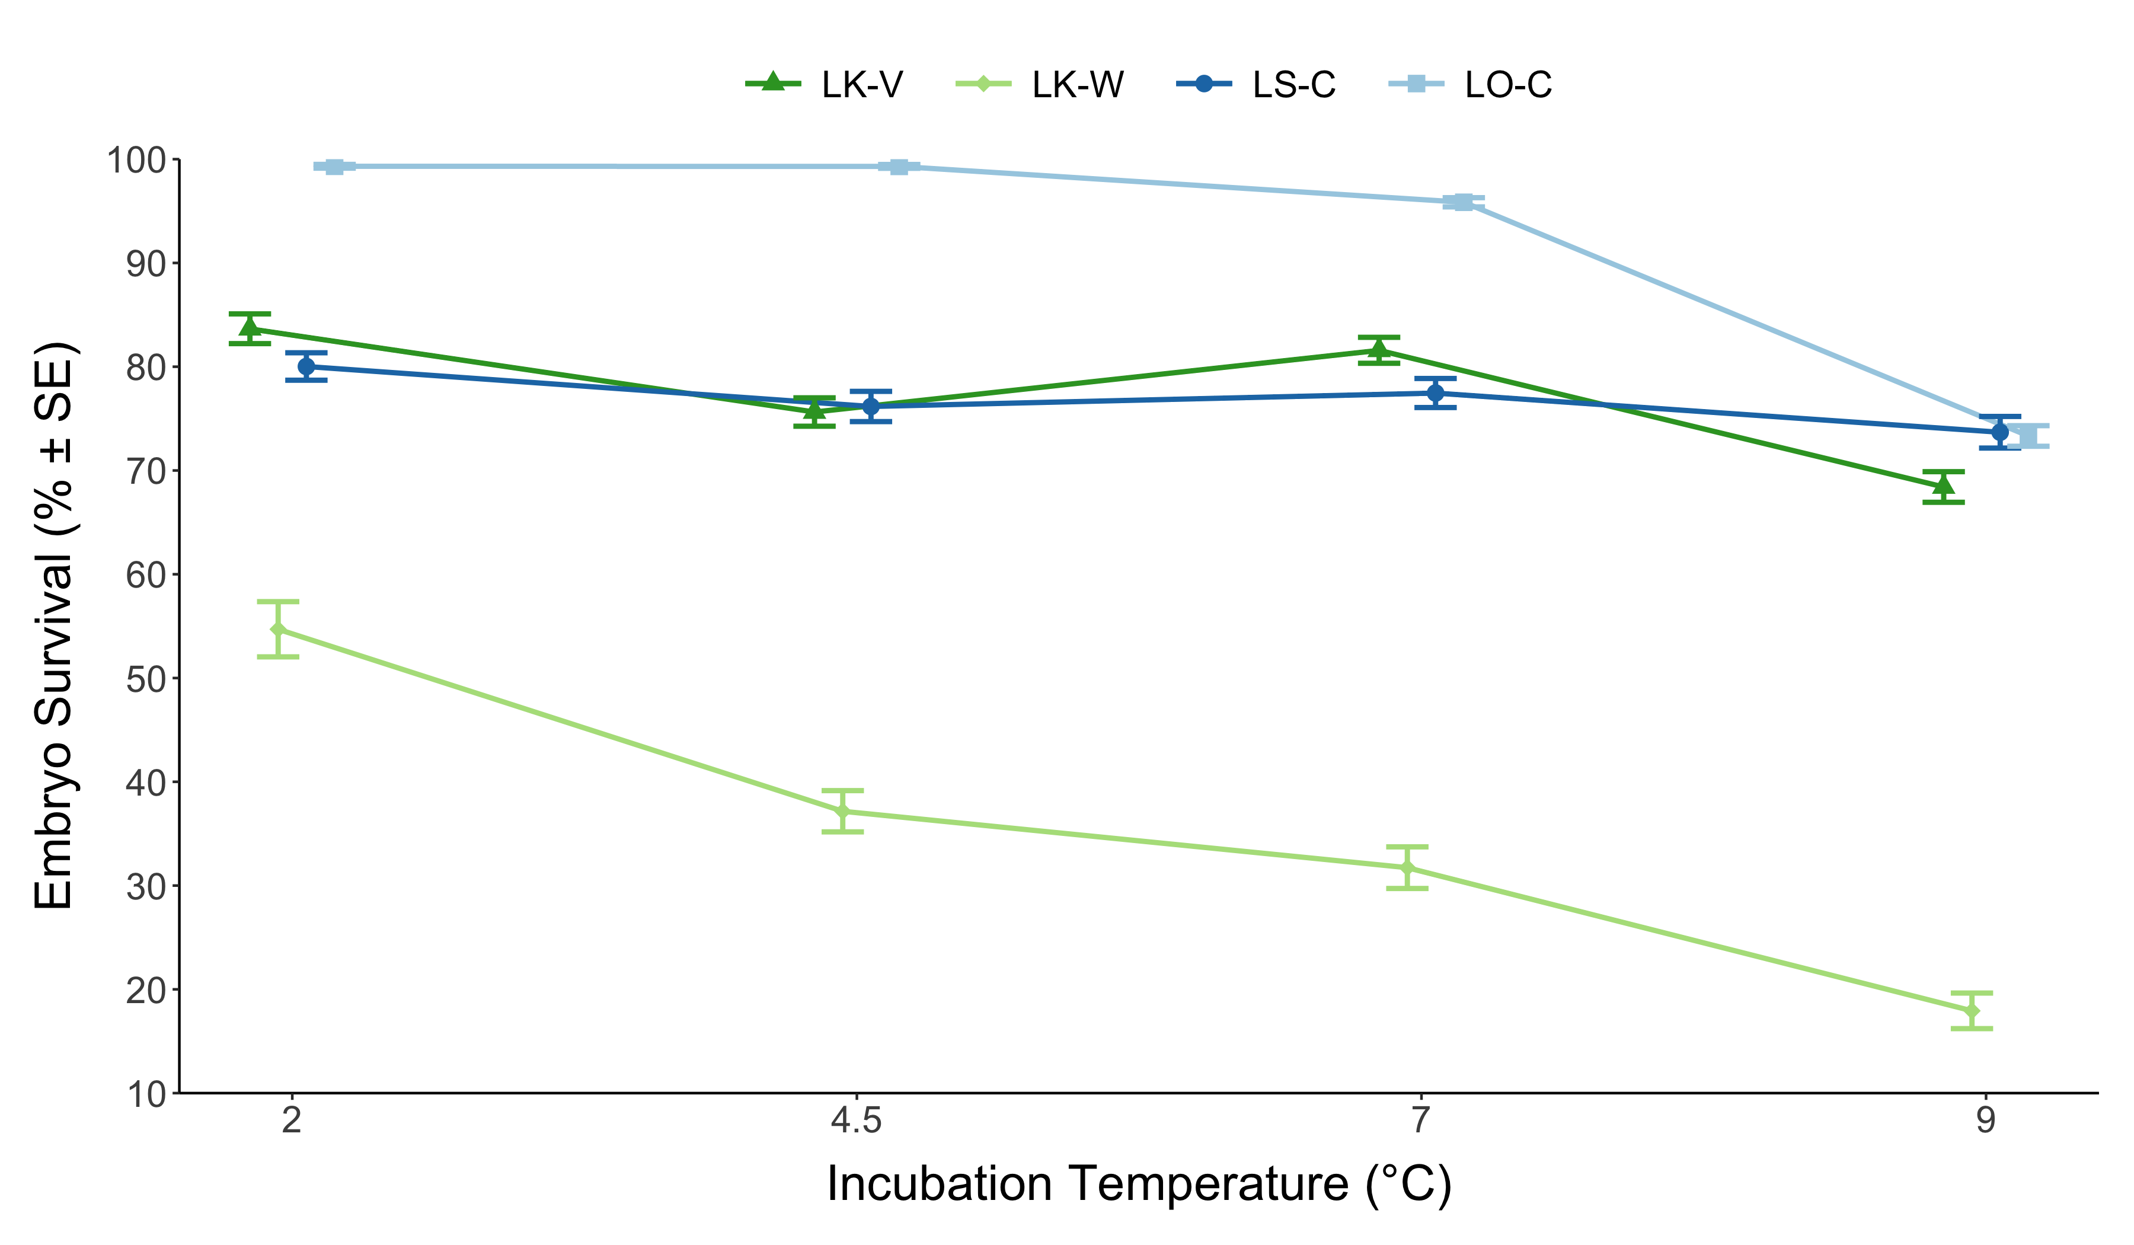
Figure X. Mean embryo survival for each population at all temperature treatments. Error bars indicate standard error.

Slide 8
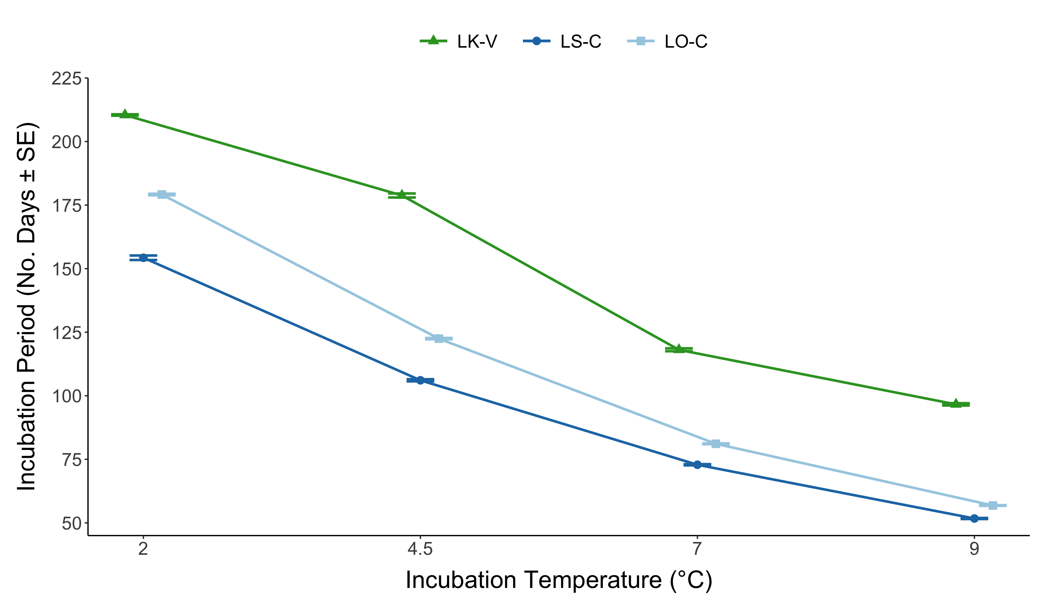
Figure X. Mean incubation period (number of days) for each population, excluding European whitefish, at all temperature treatments. Error bars indicate standard error.

Slide 9
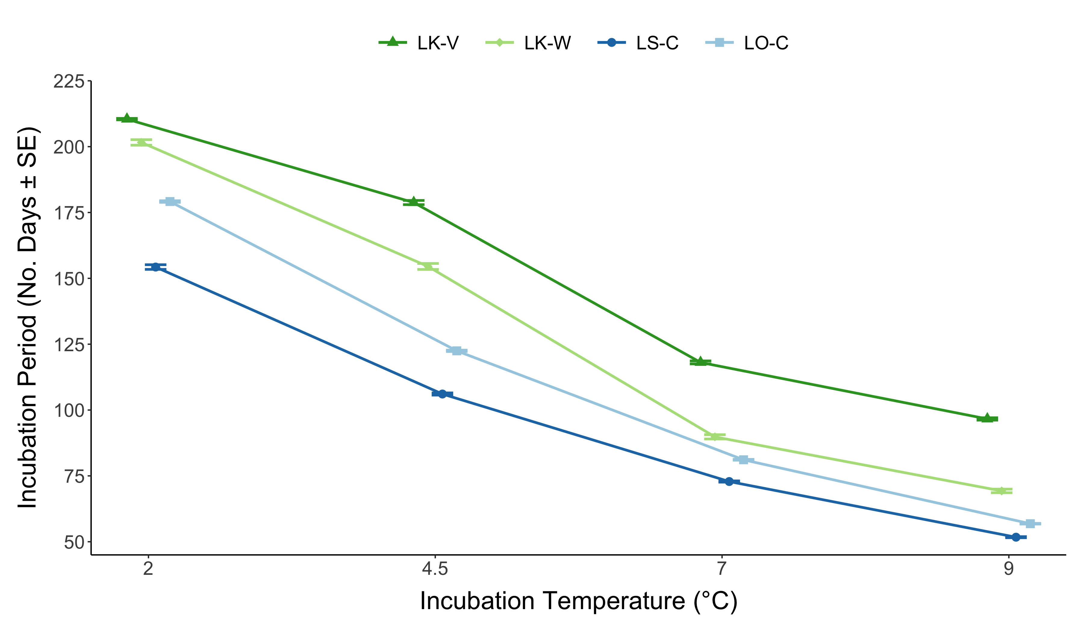
Figure X. Mean incubation period (number of days) for each population at all temperature treatments. Error bars indicate standard error.

Slide 10
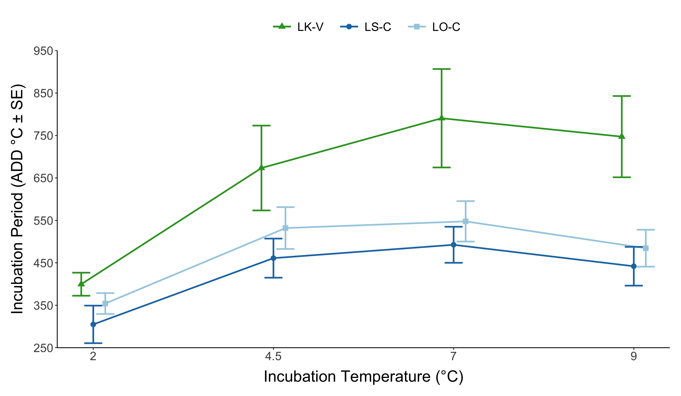
Figure X. Mean incubation period (accumulated degree-days) for each population, excluding European whitefish, at all temperature treatments. Error bars indicate standard error.

Slide 11
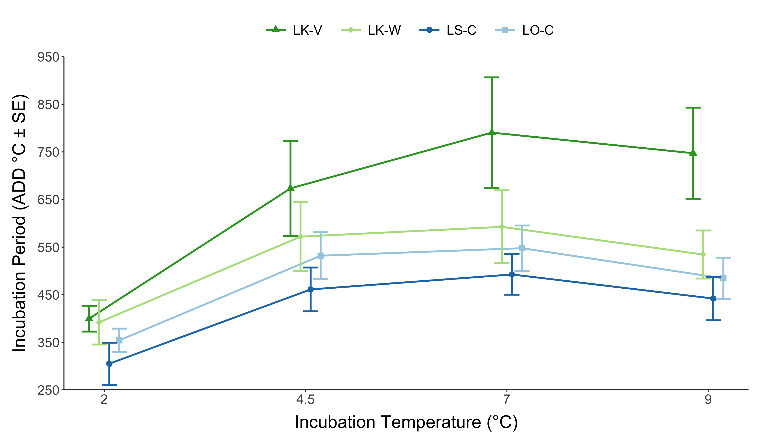
Figure X. Mean incubation period (accumulated degree-days) for each population at all temperature treatments. Error bars indicate standard error.

Slide 12
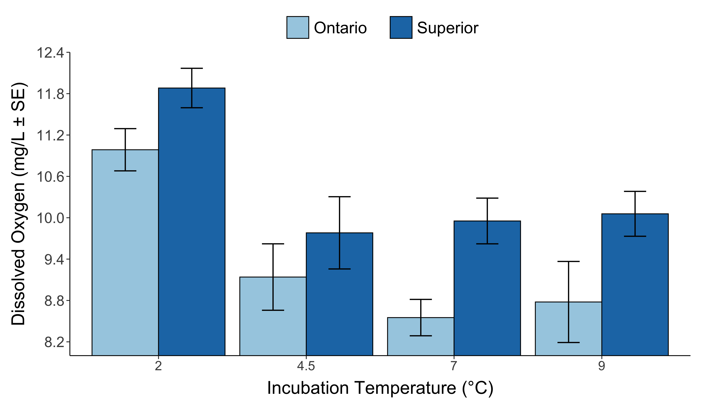

Slide 13
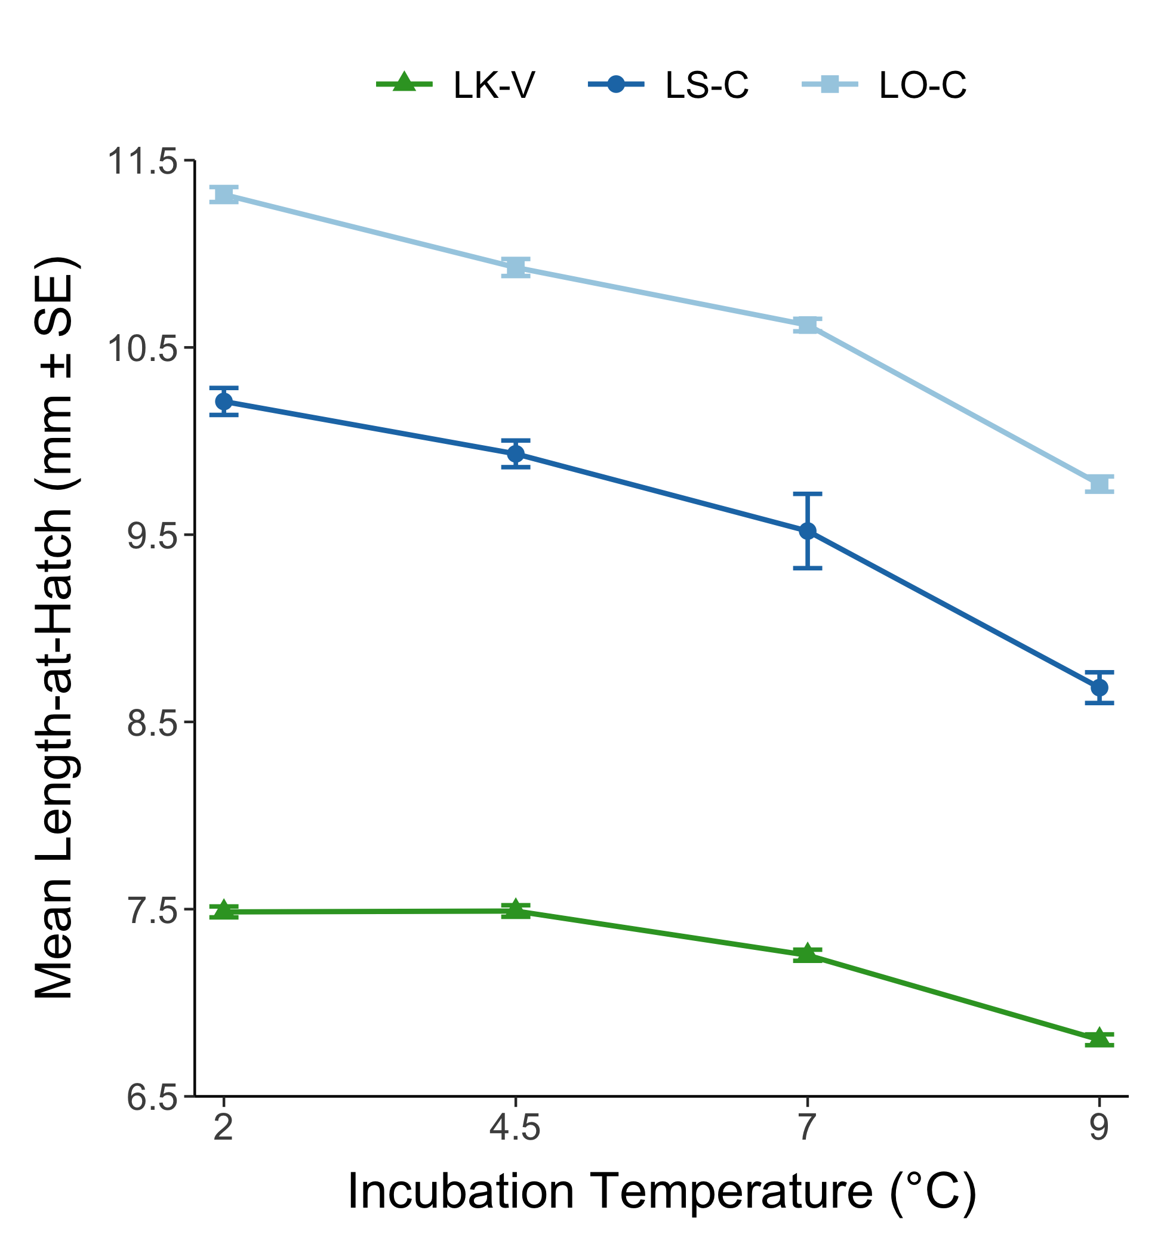
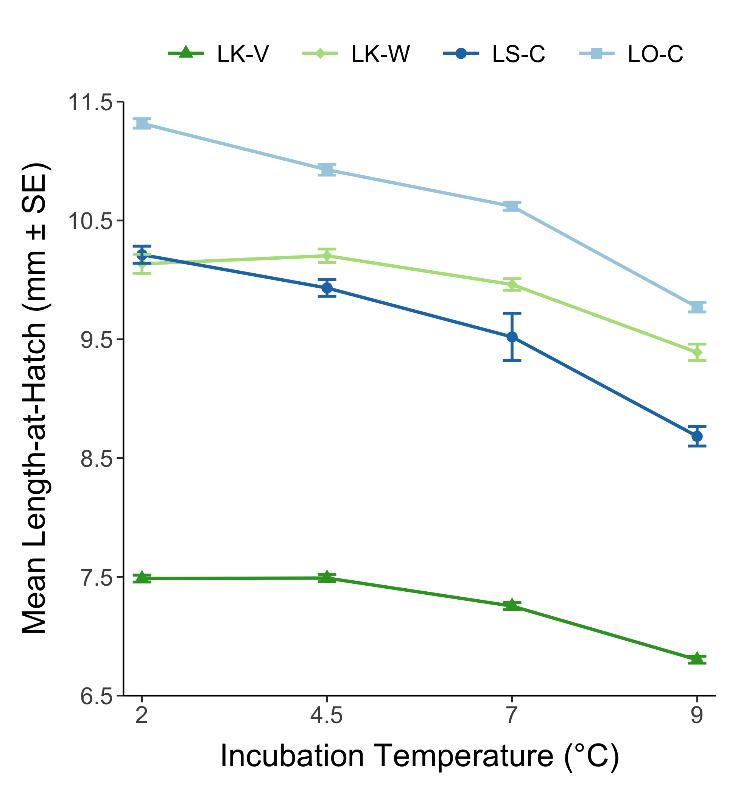
Figure X. Mean length-at-hatch for each population without (left) and with (right) European whitefish at all temperature treatments. Error bars indicate standard error.
Notes:
Left = no European whitefish, Right = with European whitefish

Slide 14
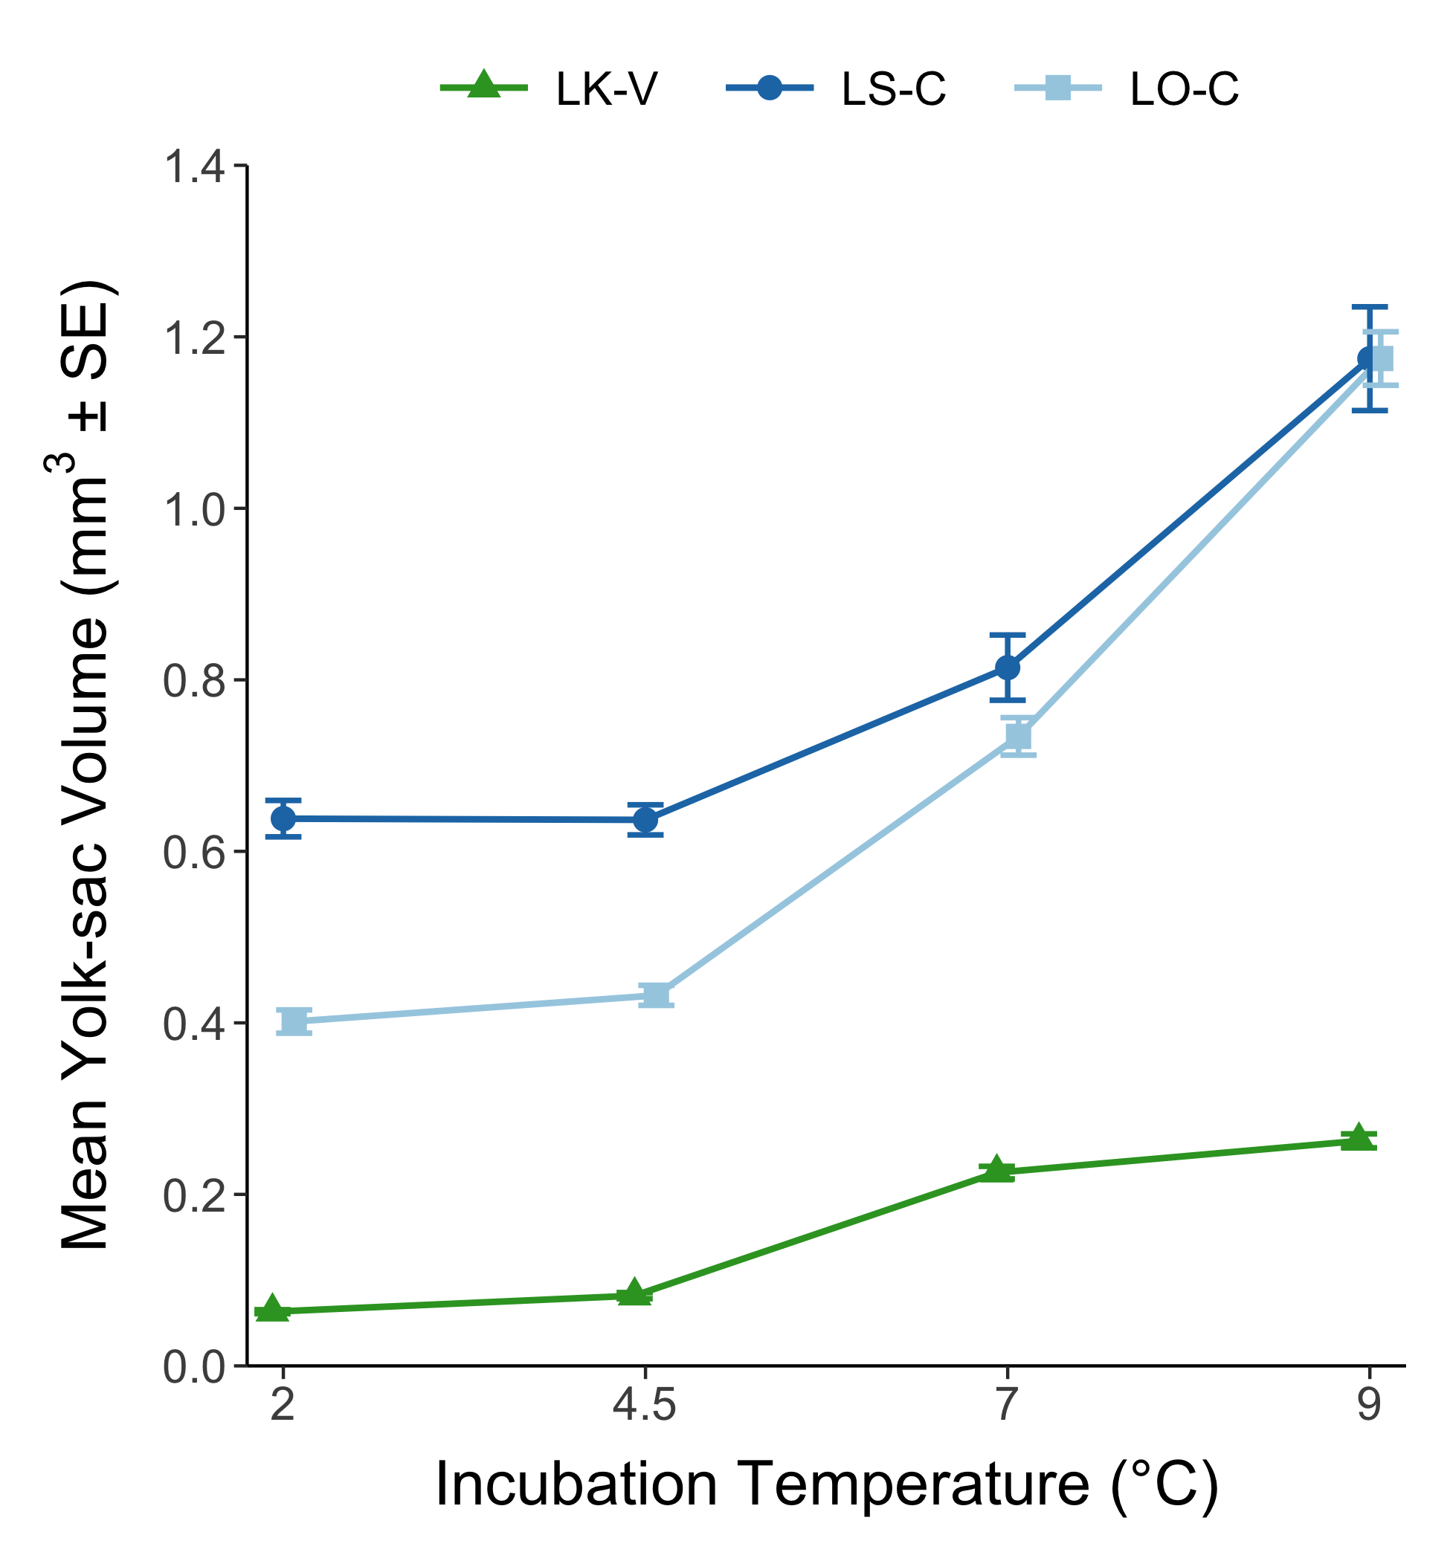
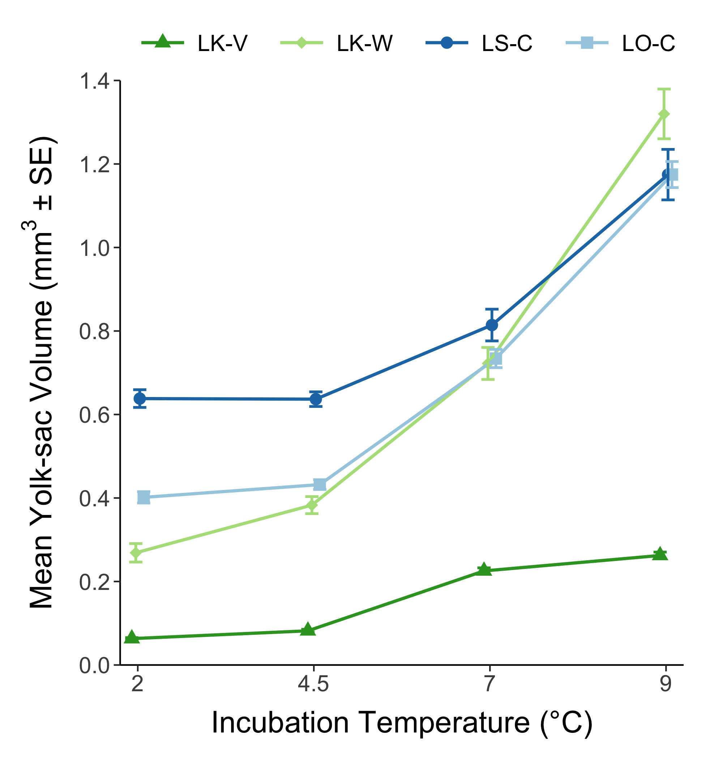
Figure X. Mean yolk-sac volume for each population without (left) and with (right) European whitefish at all temperature treatments. Error bars indicate standard error.
Notes:
Left = no European whitefish, Right = with European whitefish

